Slide 1

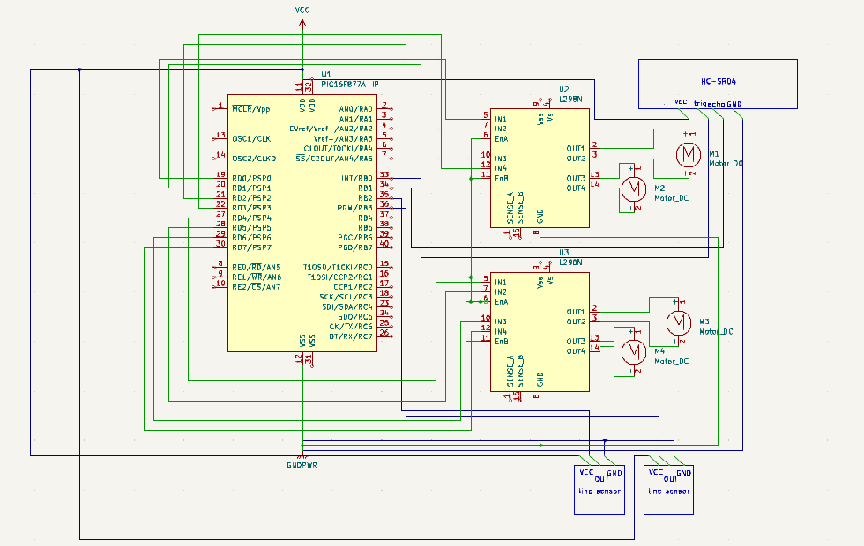
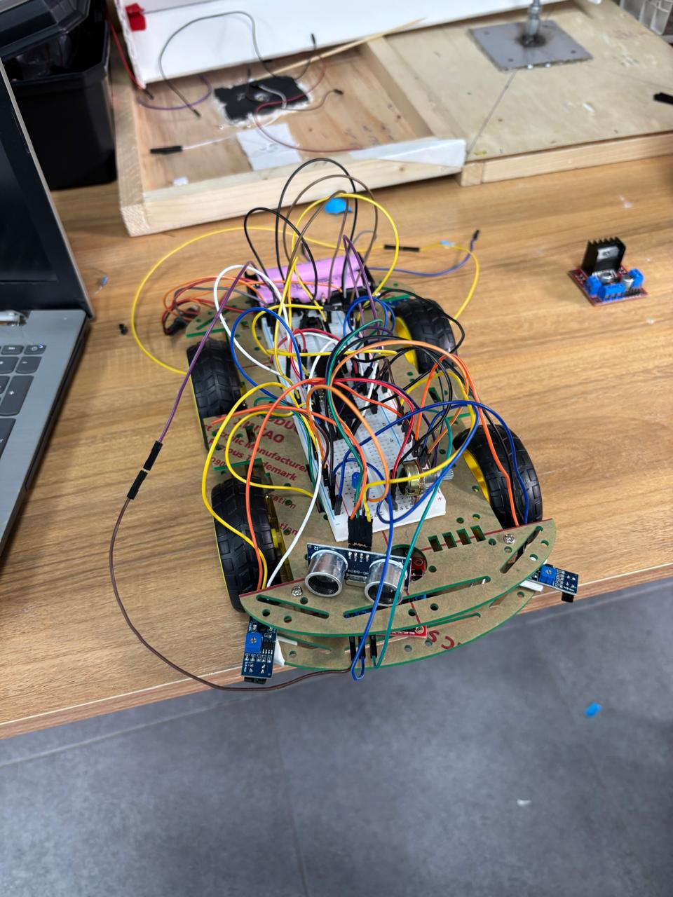


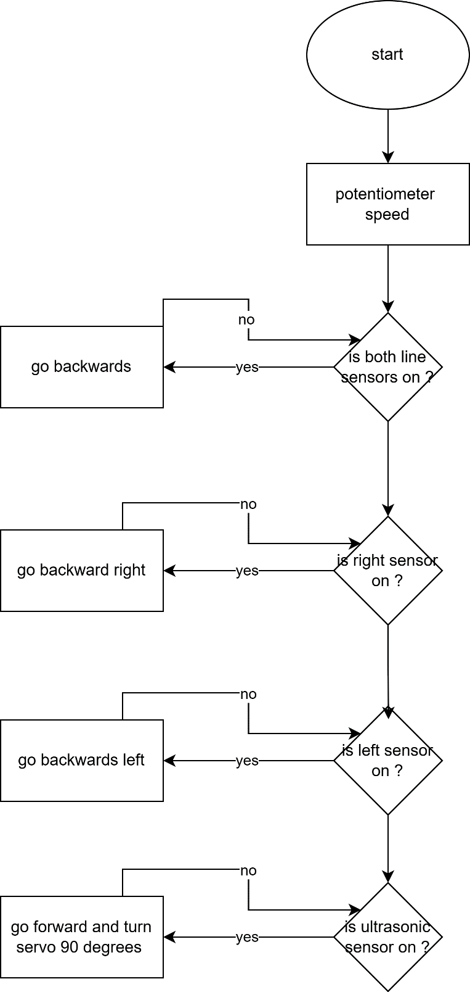
Design and implementation of a Sumo robot
A.Ismail , A.Ghanem , A.Doulat,
Supervisor: Dr. Esam Al Qaralleh
Embedded Systems Final Design Project, Fall 2024
King Abdullah II School of Engineering
Princess Sumaya University for Technology
Introduction
In our sumo robot we have built a functioning sumo robot for dueling , it operates automatically using special embedded sensors , we have used coding tricks such as pulse width modulation which enables us to control the robot speed with a potentiometer , our brain and core was the PIC16F877A chip , combined with awesome hardware such as H-bridge and ultrasonic sensos and much more ! , our project was all about making an experience to the user to play robot duels and enjoy it with clever programming .
Results
Our sumo robot exceeded our expectations , it detects lines and avoids falling out it also detects objects and pushes them out , responding efficiently to all conditions , this project demonstrates the potential of embedded systems in the world of robotics.
Scan the QR codes to access github and our youtube video :
Design
Or our sumo robot excels in navigation and checking it’s surroundings , it has 2 line sensors , an ultrasonic , 2 H-bridges and a potentiometer to control it’s speed , sensors are connected to PORTB , while potentiometer is connected to PORTC and the DC motors are connected to PORTD .
The 4 wheel design is used to have better performance and stability on ground , , electrical setup connects batteries in series for optimal dc motor performance .software uses both timer1 and timer 2 for precise timing and PWM and Ports B,C,D for efficiency . The robot navigates the black playground, skillfully .
Conclusion
creating a sumo robot faced a lot of obstacles to overcome yet the success of building a functional sumo robot was very rewarding , there is still room for improvement . Particularly in servo motor control and reduction in software , we maximized the resources in hand within our time and knowledge constraints , despite all the challenges the process of designing assembling and testing the robot was quite enjoyable and rewarding to watch the prototype come to life .

